Slide 1
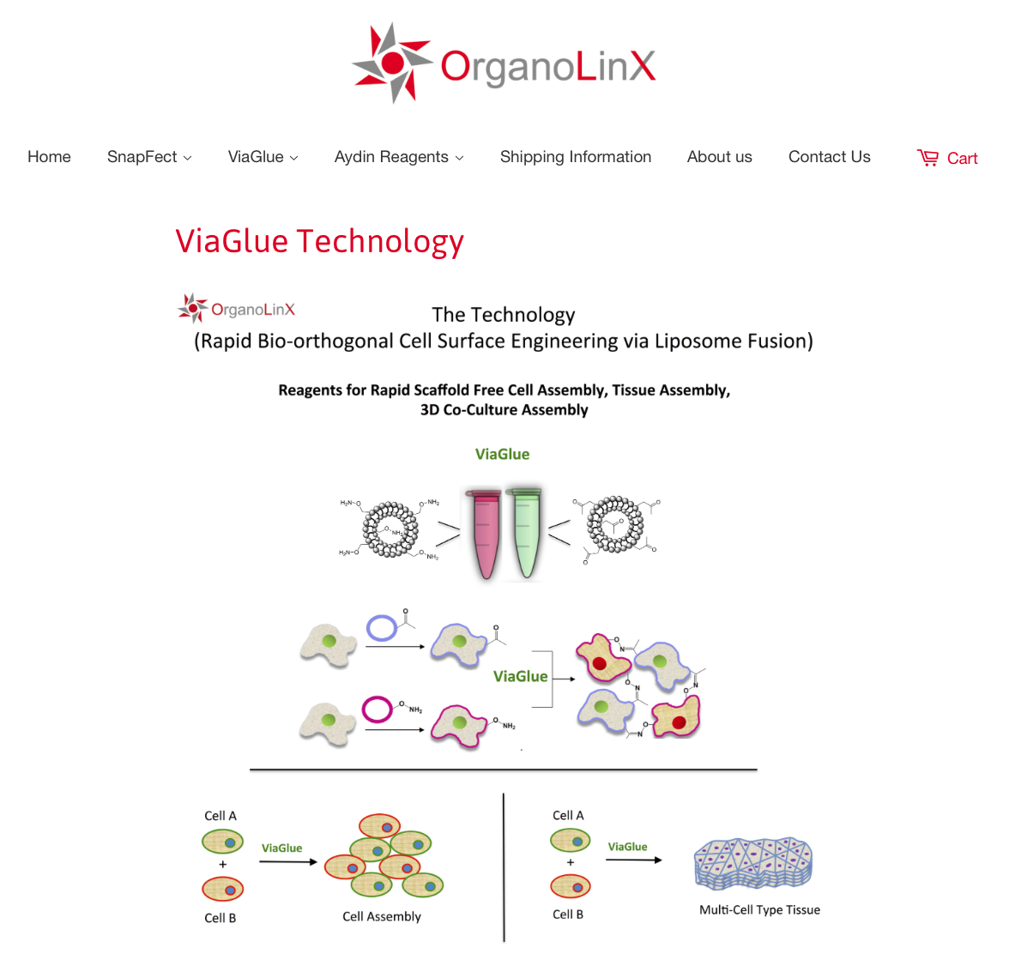
Notes:
Figure 4

Slide 2

Cell Assembly Reagent for Co-culture
Spheroids and Scaffold Free 3D Tissue
ViaGlue
Cell Assembly Reagent
TM
Efficiently Assemble any Cell Types to Generate Spheroids or 3D Tissues.
ViaGlue - A Revolutionary New Way to Assemble Cells
Combines Click Chemistry and Cell Surface Engineering to Assemble Cells.
Use Any Cell Types for Your Study
Effective in a broad range of cell lines Including primary, adherent, suspension cells and stem cells.
Get Superior Assembly Efficiency
Can generate simple or complex stable co-cultures. Assemble multiple cell types in small to large
Spheroids (2 cells to hundreds of cells). Excellent for studying cell biology signaling in co-cultures.
Platform to generate 3D Tissue containing multiple cell types for broad cell behaviour studies.
www.OrganoLinX.com
Notes:
Figure 4

